Slide 1
Addressing Modes

Slide 2
Outline
Instruction Formats
    Discussion
Addressing Modes

Slide 3
Addressing Mode:
The Way the operands are specified in the instruction
The operation to be performed is indicated by the opcode.
Operands can be in registers, memory or embedded in the instruction

Slide 4
Addressing Mode -Classification
Implied Addressing Mode
Immediate Addressing Mode
Direct Addressing Mode
Indirect Addressing Mode
Register Direct Addressing Mode
Register Indirect Addressing Mode
Displacement Addressing Mode
  Relative Addressing Mode
  Indexed Addressing Mode
  Base Addressing Mode
Auto Increment and Auto Decrement Addressing Mode

Slide 5
Implied Addressing Mode
Operand is implied / specified implicitly in the instruction
Ex:
    Complementing Accumulator
  Set or Clearing the flag bits (CLC, STC etc.)
0 – address instructions in a stack organized computer are implied mode instructions.
Effective Address (EA) = AC or Stack[SP]

Slide 6
Immediate Addressing mode
Operand embedded in the instruction
Used during program initialization
Example:- MOVE #100H, R1
Here the data 100h is moved to R1.
MVI A, 01
– MVI stands for Move Immediate. This basically implies move 01 to A.

Slide 7
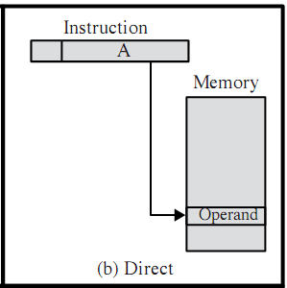
Direct addressing mode

Slide 8
Direct Addressing mode
Address field contains the effective address.
Effective address ( used to fetch operand from or a branch to)
Effective address is a part of the instruction.
Actual address of the location containing the referenced operand.

Slide 9
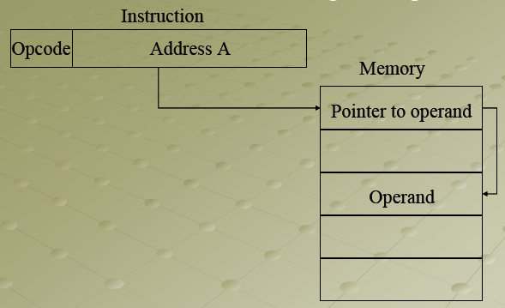
Indirect Addressing Mode Diagram

Slide 10
Indirect Addressing mode Cont”
The address field of the instruction gives the address where the effective address of the operand stored in the memory.
EA = (A)
Advantage: Large address space, may be nested, multilevel or cascaded
Disadvantage: Multiple memory accesses to find the operand, hence slower

Slide 11
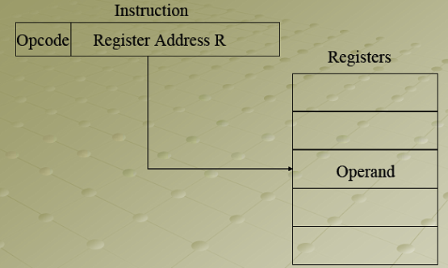
Register Addressing Diagram

Slide 12
Cont’
Operand is in the register specified in the address part of the instruction
EA = R
Ex: Mov AX, BX
Special case of direct addressing

Slide 13
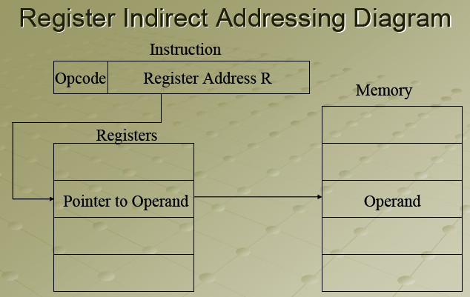

Slide 14
Cont’
Address part of the instruction specifies the register which gives the address of the operand in memory
Special case of indirect addressing
EA = (R)
Ex: Mov BX, [DX]
Advantage: Large address space
Disadvantage: Extra memory reference

Slide 15
Auto Increment and Auto Decrement Addressing Modes
This addressing mode is used when the address stored in the register refers to a table of data in memory, it is necessary to increment or decrement the register after every access to the table.
Extension to Register indirect addressing mode.
Register incremented or decremented after accessing memory
Useful while transferring large chunks of contiguous data.

Slide 16
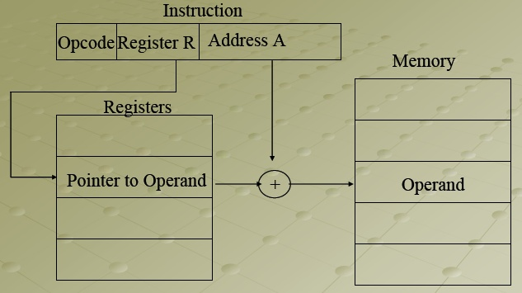
Displacement Addressing Mode
EA = A + (R)
Address field holds two values
  A = Base value
  R = register that holds displacement
  Or vice-versa

Slide 17
Relative addressing mode
It is often used in branch (conditional and unconditional) instructions, locality of reference and cache usage.
Effective address =Address part of the instruction +PC value
Advantage: Flexibility
Disadvantage: Complexity

Slide 18
Base register Addressing mode
Used to facilitate the relocation of programs in memory.
Uses Base register.
EA = Address part of the instruction +base value.
Advantage: Flexibility
Disadvantage: Complexity

Slide 19
Indexed Addressing mode
Used in performing iterative operations
Address field holds the starting address of the array.
Index register hold the actual index of the data in the array
EA = starting address(address part of an inst) + index value

Slide 20
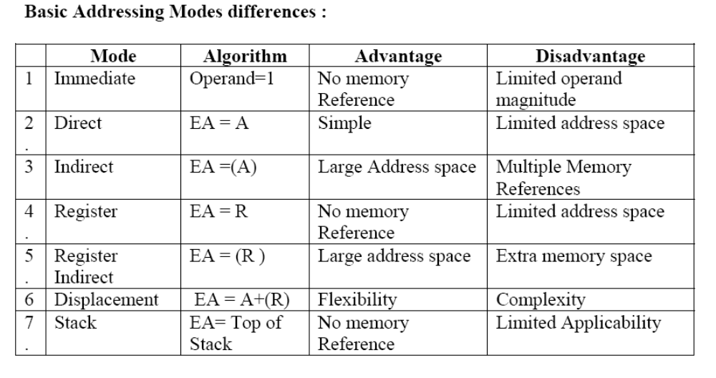
Basic Addressing Modes Differences

Slide 21
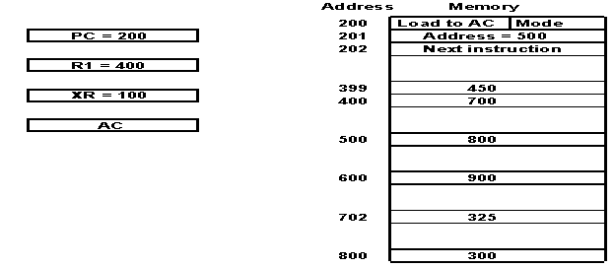
Problems
Find the effective address and the content of AC for the given data.
V.Saritha, SCSE, VIT University

Slide 22
Addressing Mode | Effective Address |  | Content of AC
Direct Address
Immediate operand
Indirect address
Relative address
Indexed address
Register
Register Indirect
Autoincrement
Autodecrement
500
AC ← (500)
800
201
AC ← 500
500
800
AC ← ((500))
300
702
AC ← (PC + 500)
325
600
AC ← (XR + 500)
900
-
AC ← R1
400
400
AC ← (R1)
700
400
AC ← (R1)+
700
399
AC ← -(R1)
450

Slide 23
Questions
An instruction is stored at location 300 with its address field at location 301. The address field has the value 400. A processor register R1 contains the number 200. Evaluate the effective address if the addressing mode of the instruction is (a) direct; (b) immediate (c) relative (d) register indirect; (e) index with R1 as the index register.
Let the address stored in the program counter be designated by the symbol X1. The instruction stored in X1 has the address part (operand reference) X2. The operand needed to execute the instruction is stored in the memory word with address X3. An index register contains the value X4. What is the relationship between these various quantities if the addressing mode of the instruction is
(a) direct (b) indirect (c) PC relative (d) indexed?

Slide 24
Assume that in a certain byte-addressed machine all instructions are 32 bits long. Assume the following state of affairs for the machine: Fill in the following table:
Address | Value
PC | 100
R0 | 200
R1 | 300
100 | 200
104 | 300
108 | 400
200 | 500
300 | 600
500 | 700
Instruction | Addressing mode | Value in R0
Load r0, #200
Load r0, 200
Load r0, (200)
Load r0,r1
Load r0, [r1]
Load r0, -100[r1]
Load r0, 200[PC]
Immediate
Direct
Indirect
Register
Register Indirect
Based
Relative

Slide 25
References
W. Stallings, Computer organization and architecture, Prentice-Hall,2000
M. M. Mano, Computer System Architecture, Prentice-Hall

